Slide 1


INSTAGRAM USER ANALYTICS
Discover the power of data analysis as we dive into a data analyst's role within Instagram's product team. Explore how user interaction insights, from marketing campaigns to app enhancements. Using MySQL Workbench, we'll showcase how meaningful data extraction steers the future of this global social media giant.
By Mahendra Singh Tekam

Slide 2
SQL Tasks
Marketing Analysis
Loyal User Reward: The marketing team wants to reward the most loyal users, i.e., those who have been using the platform for the longest time.
Inactive User Engagement: The team wants to encourage inactive users to start posting by sending them promotional emails.
Contest Winner Declaration: The team has organized a contest where the user with the most likes on a single photo wins.
Hashtag Research: A partner brand wants to know the most popular hashtags to use in their posts to reach the most people.
Ad Campaign Launch: The team wants to know the best day of the week to launch ads.

Slide 3
SQL Tasks
Investor Metrics
User Engagement: Investors want to know if users are still active and posting on Instagram or if they are making fewer posts.
Bots & Fake Accounts: Investors want to know if the platform is crowded with fake and dummy accounts.

Slide 4
SQL Tasks
Investor Metrics
User Engagement: Investors want to know if users are still active and posting on Instagram or if they are making fewer posts.
Bots & Fake Accounts: Investors want to know if the platform is crowded with fake and dummy accounts.

Slide 5
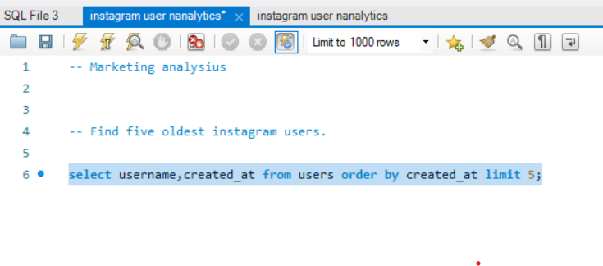
Marketing Analysis
Loyal User Reward: The marketing team wants to reward the most loyal users, i.e., those who have been using the platform for the longest time

Slide 6
Marketing Analysis
1.Loyal user reward: Our task is to find out the five oldest Instagram users. In this provided SQL dataset Ig_clone we have seven numbers of tables following that
-Comment
-Followers
-likes
-photo_tags
-photos
-tags
-users
We will select the username and created_at columns from the users table, and order them by the created_at column.

Slide 7
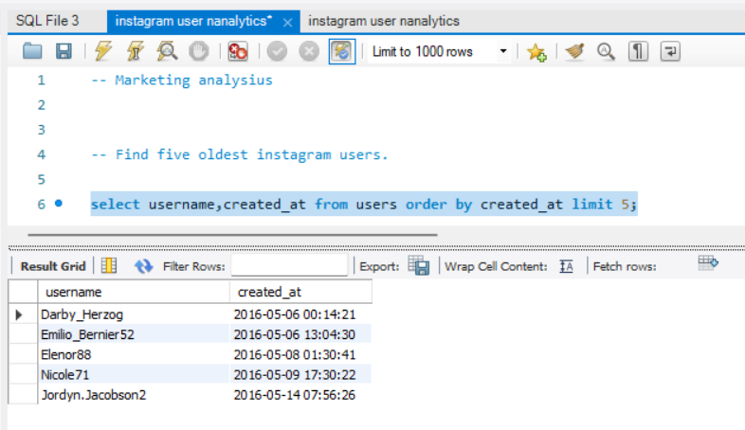
Marketing Analysis
These are the top five most seasoned users on Instagram.
Darby_Herzog
Emilio_Bernier52
Elenor88
Nicole71
Jordyn.Jacobson2
Loyal user reward: Our task is to find out the five oldest Instagram users. In this provided SQL ataset Ig_clone we have seven numbers of tables following that
-Comment
-Followers
-likes
-photo_tags
-photos
-tags
-users
So we select usename,created_at table from users and order by by created at table.

Slide 8
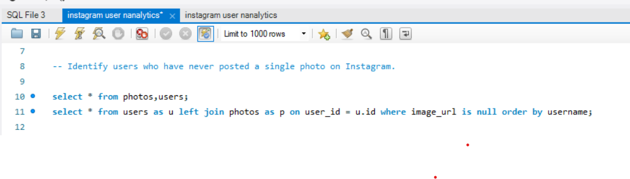
Marketing Analysis
2.Inactive User Engagement:- In this scenario, both the photos table and the users table contain a column named user_id. When we combine these tables through a join operation, a new table is created.
We need to join these tables with the help of the left join function
So we select usename,created_at table from users and order by by created at table.

Slide 9
Marketing Analysis
Inactive User Engagement
In this figure, photos and user Venn diagram demonstrate that although the photos and users tables are distinct, they are linked through a common column connected to the user_id column.
Photos
Users
With the use of a left join, we combine the tables "users" and "image_url" and include a clause to identify any null values in the "image_url“ column. This allows us to determine which users have never posted a photo on Instagram.
User_id

Slide 10
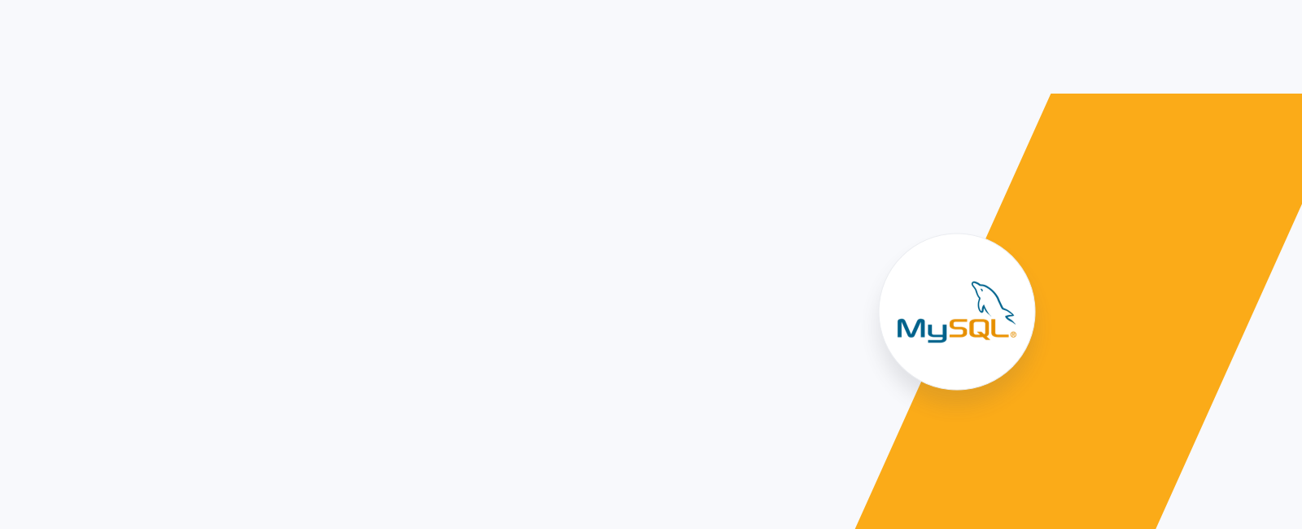
Marketing Analysis
Inactive User Engagement
select * from photos,users;
select * from users as u left join photos as p
on user_id = u.id
where image_url is null order by username;

Slide 11
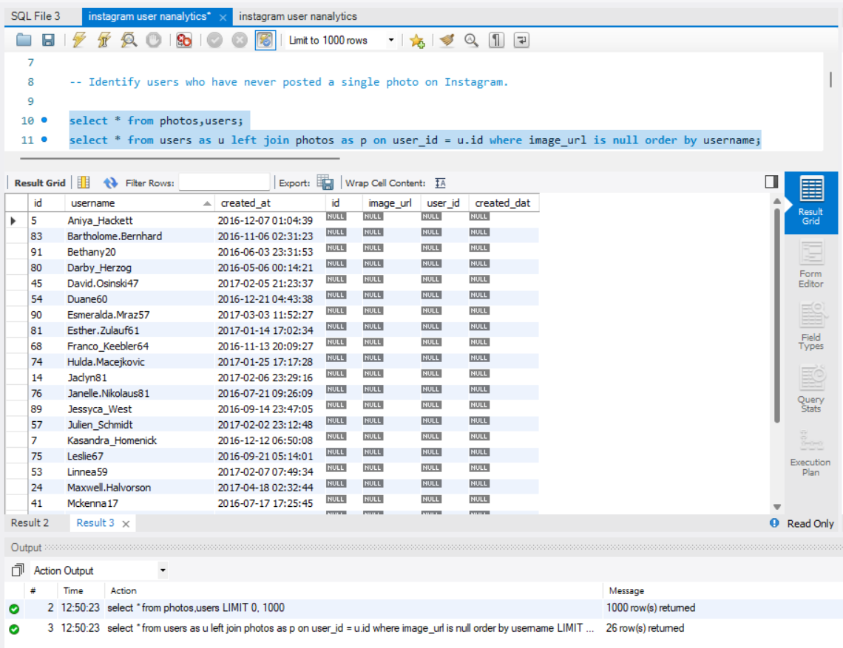
Marketing Analysis

Slide 12
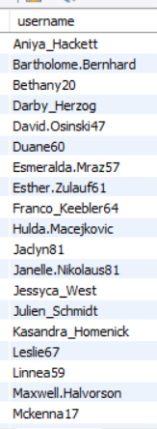
Marketing Analysis
Inactive User Engagement:-
There were 26 users on Instagram who never posted a single photo on the app.

Slide 13
Marketing Analysis
3.Contest Winner Declaration: The team has organized a contest where the user with the most likes on a single photo wins.

Slide 14
Marketing Analysis
3.Contest Winner Declaration
For this SQL task, we will be working with three tables: likes, photos, and users. Our first step is to perform an inner join between the photos and likes tables using the photos_id column. Next, we will perform another inner join between the users and photos tables using the user_id column. We will then group the data by likes.photo_id, users.username, and order by the highest number of likes. Finally, we will count the likes and display the user_id with the highest number of likes.

Slide 15
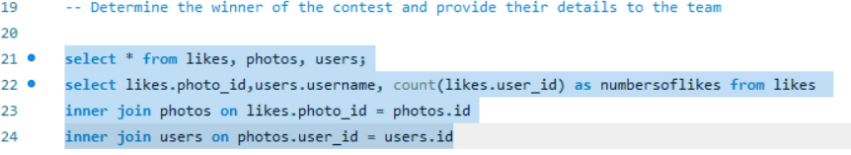
Marketing Analysis
Contest Winner Declaration
Inner join 2
Inner join 1
photos
users
likes
photos
user_id
Photo_id

Slide 16
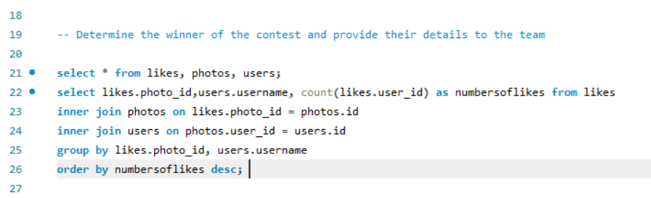

Slide 17
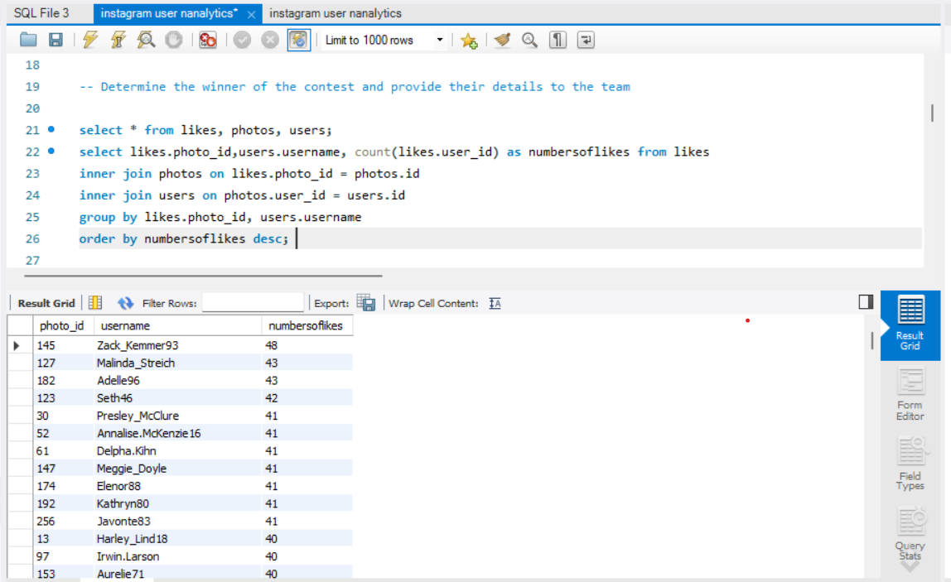

Slide 18
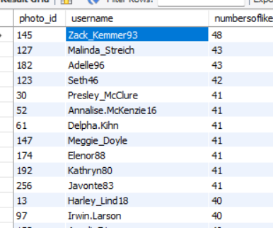
The title for the most liked photo goes to the Instagram id name is Zack_Kemmer93, with the number of 48 likes.

Slide 19
Marketing Analysis
4. Hashtag Research: A partner brand wants to know the most popular hashtags to use in their posts to reach the most people.

Slide 20

Marketing Analysis
4. Hashtag Research:- For this SQL task we will be working on these two tables first one is photo_tag and second is tags
Select * from photo_tag, tags;

Slide 21
Marketing Analysis
4. Hashtag Research:-
-- Identify and suggest the top five most commonly used hashtags
select * from photo_tags,tags;select t.tag_name,
count(p.photo_id) as hastages from photo_tags p
inner join tags t on t.id = p.tag_id
group by t.tag_name
order by hastages desc limit 5;

Slide 22
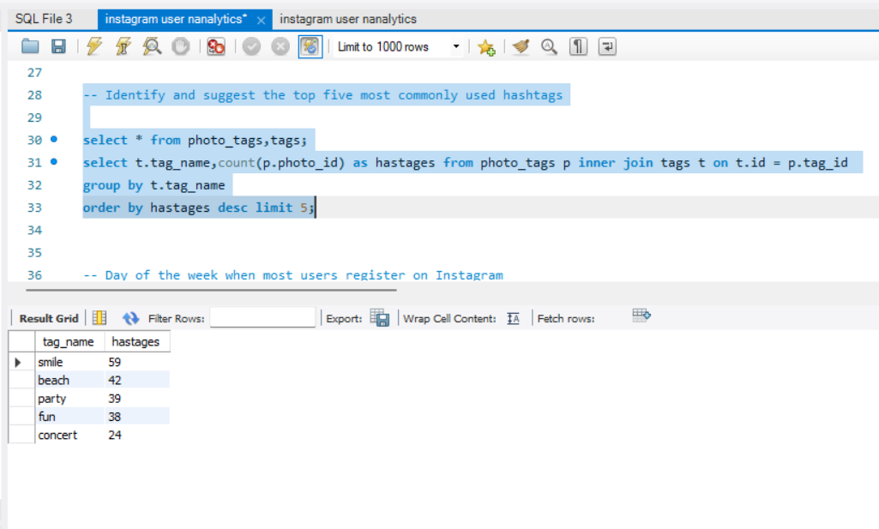
Marketing Analysis
4. Hashtag Research:-

Slide 23
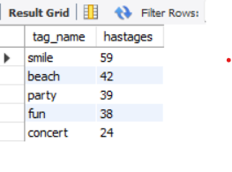
Marketing Analysis
A brand partner is seeking information on the most widely used hashtags that can help them reach a larger audience through their posts. Some of the popular hashtags include #smile, #beach, #party, #fun, and #concert.

Slide 24
Marketing Analysis
5. Ad Campaign Launch: The team wants to know the best day of the week to launch ads.most people.

Slide 25
Marketing Analysis
Ad Campaign Launch:
For this SQL task, we will determine the most popular day of the week for user registration on Instagram. This information will be provided to the team to assist in scheduling an ad campaign.
HOW:- To retrieve data from the users table, use the date_format command on the created_at column. Specify %W to get the day of the week. Then, count the number of usernames from the users table, group them by the day of week , and order them by the username.

Slide 26

Marketing Analysis
Ad Campaign Launch:
select * from users;select date_format((created_at), '%W') as dow, count(username) from users
group by 1
order by 2 desc;

Slide 27
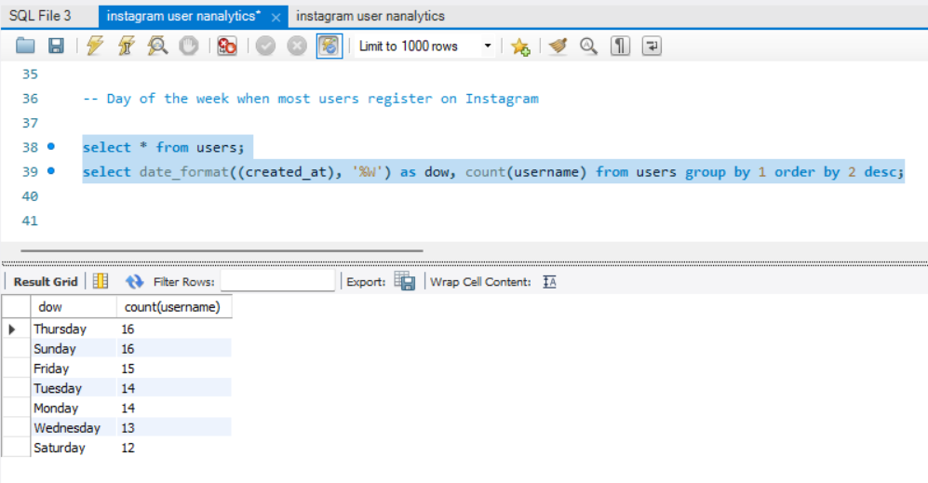
Marketing Analysis
Ad Campaign Launch:

Slide 28
Marketing Analysis
Ad Campaign Launch:
The team is seeking information on the optimal days of the week to launch ads, specifically inquiring about the effectiveness of Thursday and Sunday.

Slide 29
Investor Metrics
User Engagement: Investors want to know if users are still active and posting on Instagram or if they are making fewer posts.

Slide 30
Investor Metrics
User Engagement
To do this, we'll be using the photos and users table in SQL. To create a temporary table, we'll be using the WITH clause.
Let's call this temporary table "temp_table". We'll select the user_id and count the photo_id from the users table, then left join it with the photo table on the user_id and group it by user_id.
After that, we'll select the photo_id and apply the sum clause to find the total number of photos. We'll count the user_id as the total number of users, sum the photo_id, and divide it by the count of total users to find the photo per user ratio.

Slide 31

Investor Metrics
SELECT * FROM photos,users;
with temp_table as(select u.id as userid,count(p.id) as photoid from users u left join photos p on p.user_id=u.id
group by u.id)
SELECT * FROM photos,users;with temp_table as(select u.id as userid,count(p.id) as photoid from users u left join photos p on p.user_id=u.idgroup by u.id)

Slide 32
Investor Metrics
User Engagement
After that, we'll select the photo_id and apply the sum clause to find the total number of photos. We'll count the user_id as the total number of users, sum the photo_id, and divide it by the count of total users to find the photo per user ratio.

Slide 33
Investor Metrics
select sum(photoid) as totalphotos,count(userid) as total_users,sum(photoid)/count(userid)as photoperuser from temp_table
SELECT * FROM photos,users;with temp_table as(select u.id as userid,count(p.id) as photoid from users u left join photos p on p.user_id=u.idgroup by u.id)

Slide 34
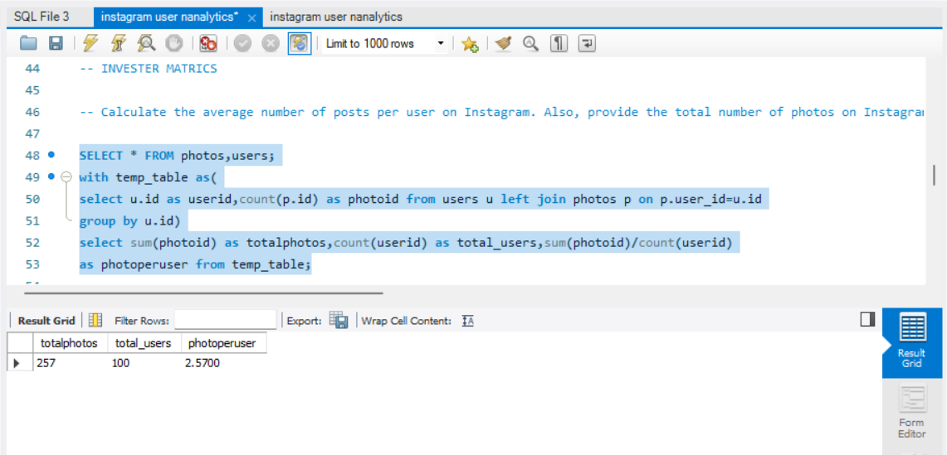
Investor Metrics
SELECT * FROM photos,users;with temp_table as(select u.id as userid,count(p.id) as photoid from users u left join photos p on p.user_id=u.idgroup by u.id)

Slide 35
Investor Metrics
According to our calculations, the average number of photos per user on Instagram is 2.57. Additionally, there are a total of 257 photos on Instagram and 100 users on the platform.

Slide 36
Investor Metrics
2.Bots & Fake Accounts: Investors want to know if the platform is crowded with fake and dummy accounts.

Slide 37
Investor Metrics
For this SQL task, we will use the Users and Likes tables and the "WITH" clause to create a temporary table. We will then identify accounts that have liked all available post photos on Instagram. These accounts will be declared as bots or fake accounts.

Slide 38

Investor Metrics
select * from users,likes;with temp_table as
(select u.username,count(l.photo_id) as likes
from likes l inner join users u on u.id = l.user_id
group by u.username)
select username,likess from temp_table
where likess = (select count(*) from photos)
order by username

Slide 39
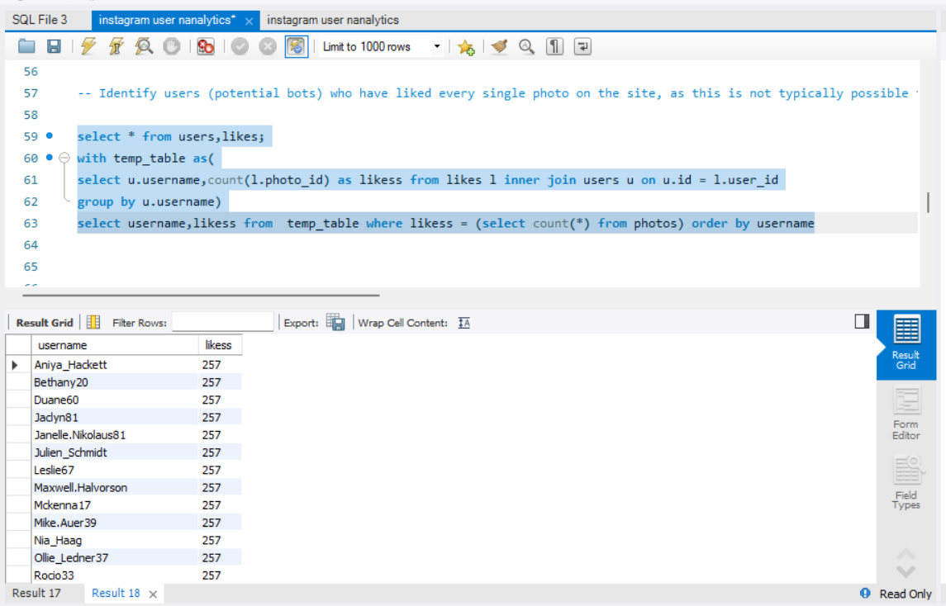
Investor Metrics
Bot and fake accounts

Slide 40
Investor Metrics
There are 13 bots or fake accounts in the Instagram account dataset provided.

Slide 41


My learnings of SQL

Slide 42



Softweres

Slide 43
Thank you

